Slide 1
Wave guide
Basic features
Rectangular Wave guide
Circular Wave guide
Applications
PH0101 Unit 2 Lecture 4

Slide 2
Waveguides
Introduction
At frequencies higher than 3 GHz, transmission of electromagnetic energy along the transmission lines and cables becomes difficult.
This is due to the losses that occur both in the solid dielectric needed to support the conductor and in the conductors themselves.
A metallic tube can be used to transmit electromagnetic wave at the above frequencies
PH0101 Unit 2 Lecture 4

Slide 3
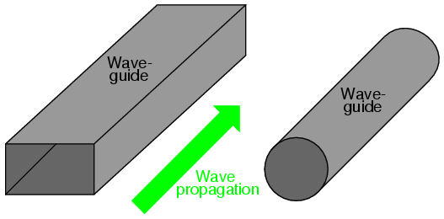
Definition
A Hollow metallic tube of uniform cross section for transmitting electromagnetic waves by successive reflections from the inner walls of the tube is called waveguide.
PH0101 Unit 2 Lecture 4

Slide 4
Basic features
Waveguides may be used to carry energy between pieces of equipment or over longer distances to carry transmitter power to an antenna or microwave signals from an antenna to a receiver
Waveguides are made from copper, aluminum or brass. These metals are extruded into long rectangular or circular pipes.
An electromagnetic energy to be carried by a waveguide is injected into one end of the waveguide.
The electric and magnetic fields associated with the signal bounce off the inside walls back and forth as it progresses down the waveguide.
PH0101 Unit 2 Lecture 4

Slide 5
EM field configuration within the waveguide
In order to determine the EM field configuration within the waveguide, Maxwell’s equations should be solved subject to appropriate boundary conditions at the walls of the guide.
Such solutions give rise to a number of field configurations. Each configuration is known as a mode. The following are the different modes possible in a waveguide system
PH0101 Unit 2 Lecture 4

Slide 6
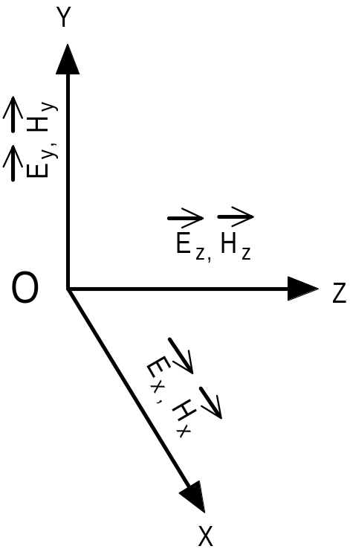
Components of Electric and Magnetic Field Intensities in an EM wave
PH0101 Unit 2 Lecture 4

Slide 7
Possible Types of modes
1. Transverse Electro Magnetic (TEM) wave:
Here both electric and magnetic fields are directed
components. (i.e.) E _{z} = 0 and H_{z} = 0
2. Transverse Electric (TE) wave: Here only the electric field is purely transverse to the direction of propagation and the magnetic field is not purely transverse. (i.e.) E _{z} = 0, H_{z} ≠ 0
PH0101 Unit 2 Lecture 4

Slide 8
Possible Types of modes
3. Transverse Magnetic (TM) wave: Here only magnetic field is transverse to the direction of propagation and the electric field is not purely transverse. (i.e.) E _{z} ≠ 0, H_{z} = 0.
4. Hybrid (HE) wave: Here neither electric nor
magnetic fields are purely transverse to the direction of propagation. (i.e.) E _{z} ≠ 0, H_{z} ≠ 0.
PH0101 Unit 2 Lecture 4

Slide 9
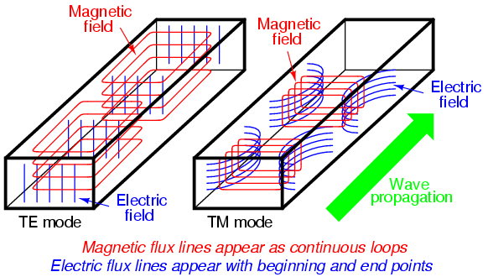
PH0101 Unit 2 Lecture 4

Slide 10
Rectangular Waveguides
Any shape of cross section of a waveguide can support electromagnetic waves of which rectangular and circular waveguides have become more common.
A waveguide having rectangular cross section is known as Rectangular waveguide
PH0101 Unit 2 Lecture 4

Slide 11
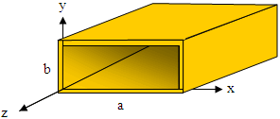
Rectangular waveguide
Dimensions of the waveguide which determines the operating frequency range
PH0101 Unit 2 Lecture 4

Slide 12
Dimensions of the waveguide which determines the operating frequency range:
The size of the waveguide determines its operating frequency range.
2. The frequency of operation is determined by the
dimension ‘a’.
3. This dimension is usually made equal to one – half the wavelength at the lowest frequency of operation, this frequency is known as the waveguide cutoff frequency.
4. At the cutoff frequency and below, the waveguide will
not transmit energy. At frequencies above the cutoff
frequency, the waveguide will propagate energy.
PH0101 Unit 2 Lecture 4

Slide 13
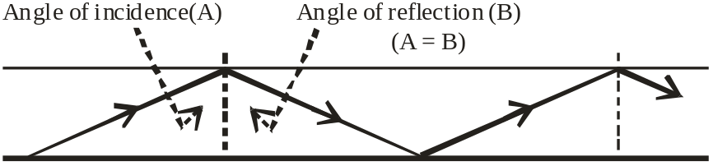
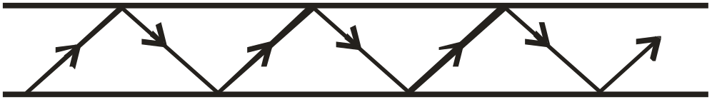
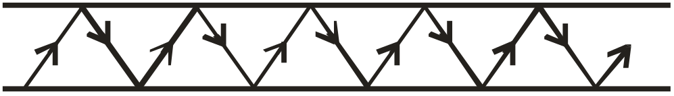
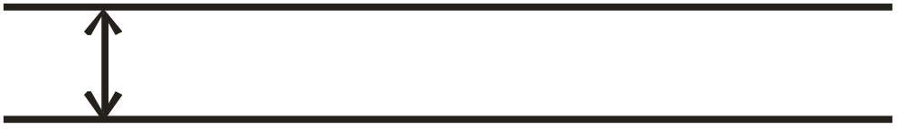
Wave paths in a waveguide at various frequencies
At high
frequency
(b) At medium
frequency
( c ) At low frequency
(d) At cutoff frequency
PH0101 Unit 2 Lecture 4

Slide 14
Wave propagation
When a probe launches energy into the waveguide, the electromagnetic fields bounce off the side walls of the waveguide as shown in the above diagram.
The angles of incidence and reflection depend upon the operating frequency. At high frequencies, the angles are large and therefore, the path between the opposite walls is relatively long as shown in Fig.
PH0101 Unit 2 Lecture 4

Slide 15
At lower frequency, the angles decrease and the path between the sides shortens.
When the operating frequency is reaches the cutoff frequency of the waveguide, the signal simply bounces back and forth directly between the side walls of the waveguide and has no forward motion.
At cut off frequency and below, no energy will propagate.
PH0101 Unit 2 Lecture 4

Slide 16
Cut off frequency
The exact size of the wave guide is selected based on the desired operating frequency.
The size of the waveguide is chosen so that its rectangular width is greater than one – half the wavelength but less than the one wavelength at the operating frequency.
This gives a cutoff frequency that is below the operating frequency, thereby ensuring that the signal will be propagated down the line.
PH0101 Unit 2 Lecture 4

Slide 17
Representation of modes
The general symbol of representation will be TE _{m, n} or TM _{m, n} where the subscript m indicates the number of half wave variations of the electric field intensity along the b ( wide) dimension of the waveguide.
The second subscript n indicates the number of half wave variations of the electric field in the a (narrow) dimension of the guide.
The TE _{1, 0} mode has the longest operating wavelength and is designated as the dominant mode. It is the mode for the lowest frequency that can be propagated in a waveguide.
PH0101 Unit 2 Lecture 4

Slide 18
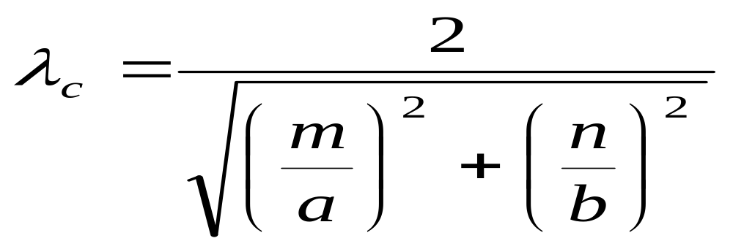
Expression for cut off wavelength
For a standard rectangular waveguide, the cutoff wavelength is given by,
Where a and b are measured in centimeters
PH0101 Unit 2 Lecture 4

Slide 19
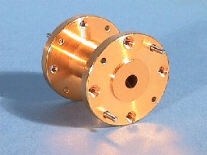
Circular wave guide
A Hollow metallic tube of uniform circular cross section for transmitting electromagnetic waves by successive reflections from the inner walls of the tube is called Circular waveguide.
PH0101 Unit 2 Lecture 4

Slide 20
Circular wave guide
The circular waveguide is used in many special applications in microwave techniques.
It has the advantage of greater power – handling capacity and lower attenuation for a given cutoff wavelength. However, the disadvantage of somewhat greater size and weight.
The polarization of the transmitted wave can be altered due to the minor irregularities of the wall surface of the circular guide, whereas the rectangular wave guide the polarization is fixed
PH0101 Unit 2 Lecture 4

Slide 21
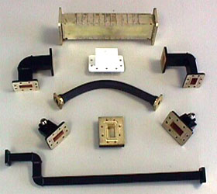
PH0101 Unit 2 Lecture 4

Slide 22
Description
The wave of lowest frequency or the dominant mode in the circular waveguide is the TE₁₁ mode.
The first subscript m indicates the number of full – wave variations of the radial component of the electric field around the circumference of the waveguide.
The second subscript n indicates the number of half – wave variations across the diameter.
The field configurations of TE₁₁ mode in the circular waveguide is shown in the diagram below
PH0101 Unit 2 Lecture 4

Slide 23
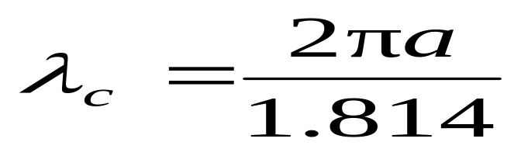
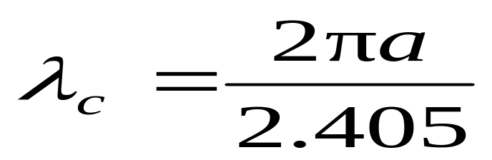
Cut off wavelength
The cutoff wavelength for dominant mode of propagation TE₁₁ in circular waveguide of radius ‘a’ is given by
The cutoff wavelength for dominant mode of propagation TM₀₁ in circular waveguide of radius ‘a’ is given by
PH0101 Unit 2 Lecture 4

Slide 24
Applications of circular waveguide
Rotating joints in radars to connect the horn antenna feeding a parabolic reflector (which must rotate for tracking)
TE₀₁ mode suitable for long distance waveguide transmission above 10 GHz.
Short and medium distance broad band communication (could replace / share coaxial and microwave links)
PH0101 Unit 2 Lecture 4

